Slide 1
Predicting plasticity outcomes based on LFP magnitude
Sebastiano Bariselli &
Bridget Matikainen-Ankney
BIOF309, Spring 2018

Slide 2
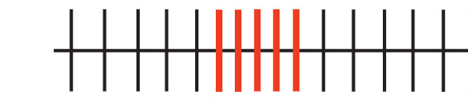
Background
Neural plasticity:
The ability of connections between neurons to change
a
c
b
PRE
POST

Slide 3
Question
Can we predict plasticity outcomes based on local field potential magnitude during PRE period?

Slide 4
Project goals
Import data
Clean data (outliers)
Data visualization
Use prediction model

Slide 5
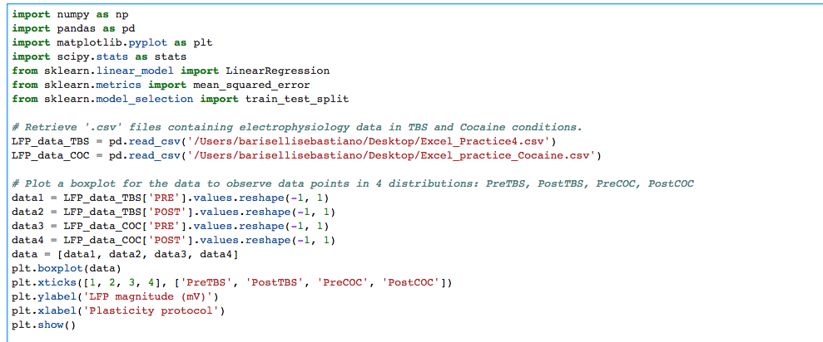
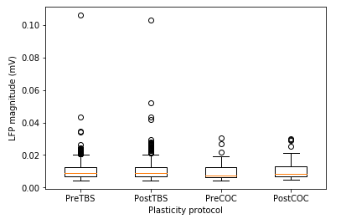
IMPORT DATA
Outliers?

Slide 6
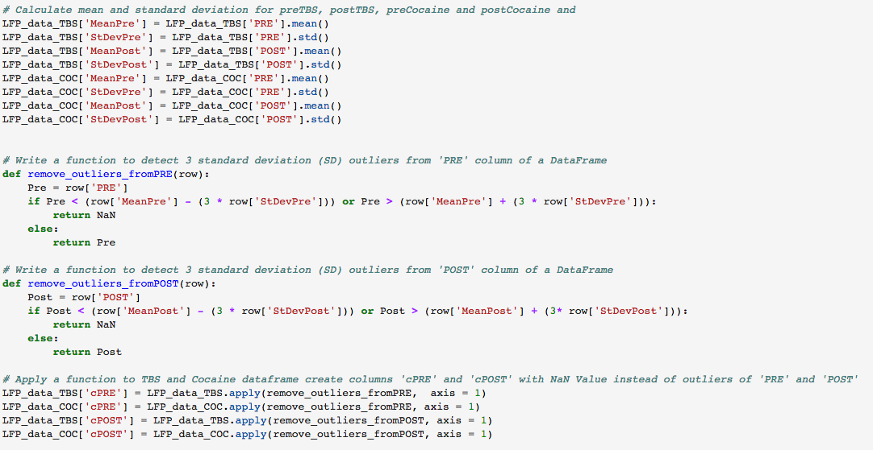
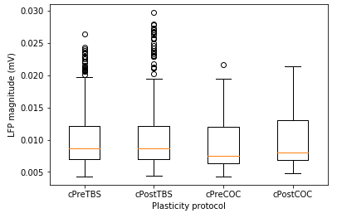
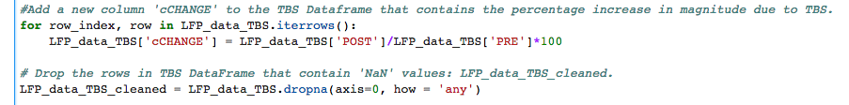
CLEANING THE DATAFRAME

Slide 7
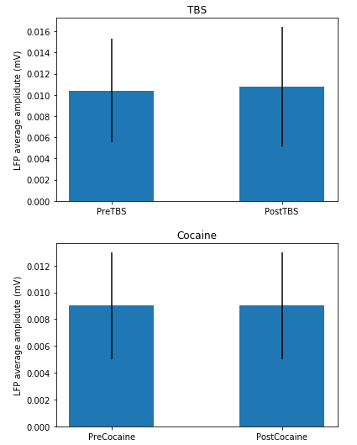
Is there a plasticity?

Slide 8
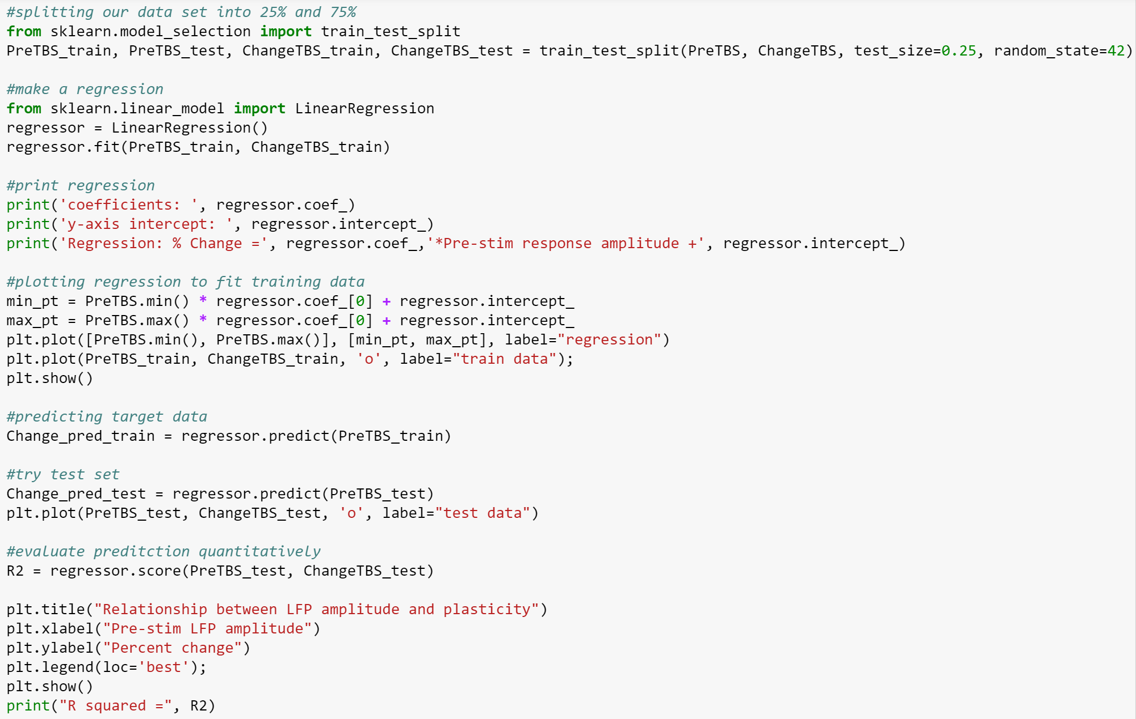
REGRESSION ANALYSIS

Slide 9
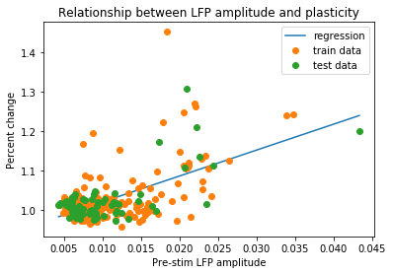
Regression analysis
Regression: % Change = [ 6.55694474] *Pre-stim response amplitude + 0.954975708918
R squared = 0.471091816409

Slide 10
Conclusions
LFP magnitude at PRE does predict plasticity outcomes given a linear models (R2 = 0.47).
2) This code will be used to organize and analyze neural data.

